Slide 1
Search Engines for the Web - Making use of Links and HTML Tags -

Slide 2
Historical Review of Link-Based Ranking Methods

Slide 3
Problems with Term-Based Ranking
Ranking based on a document’s terms alone is problematic. Consider http://www.ust.hk/
No mention of HKUST (in text form) in page body, contained HKUST once and “Hong Kong University of Science and Technology” twice in metatags
The main (content) frame contains HKUST twice, and “Hong Kong University of Science and Technology” once in text form and once as a GIF file
Yet www.ust.hk is ranked number 1 in the result
This page will not likely be ranked high based on keywords alone
You can create a page containing many instances of “hkust” and make it rank higher than www.ust.hk (search engine spamming)
These numbers may change as the webpage is updated

Slide 4
Going Beyond Document Content
What is contained in a document is not enough for judging the document’s relevance to the query
Need to go beyond the document body:
Web structure such as links between documents
Document properties such as last modified date (fresh document considered more relevant), URL (domain name matching a query term), etc.
User statistics such as page views (popular pages are more relevant), clickthroughs on the results
Many other possibilities: see Google’s ranking factors

Slide 5
Benefits of Using Links
Basic assumption: when two web pages are linked together, there must be some relationship or similarity between them
Links may be used to estimate similarity between web pages which are otherwise unrelated according to term-based similarity
Links may return pages which don’t contain the query words or don’t contain the query words frequent enough to be retrieved by term-based ranking methods
Sport
Cycling
Searching for “sport” or searching for “cycling” will return both pages with the exact-matching page will rank much higher

Slide 6
HyPursuit at MIT (1996)
Direct Path: Similarity between two documents varies inversely with the shortest path length (spl) between the two documents.
x
j
Shortest path length from j to i
Shortest path length from i to j

Slide 7
HyPursuit at MIT (1996)
Common Ancestor: Similarity between two documents is proportional to the number of common ancestors of the two documents.
i
x
j
Shortest path length from x to j without passing through i
Shortest path length from x to i without passing through j

Slide 8
HyPursuit at MIT (1996)
Common Descendants: Similarity between two documents is proportional to the number of common descendants of the two documents.
The final link-based similarity is a combination of the shortest path, common parent and common child similarities
The link-based similarity is then combined with term-based similarity, which is based on the vector space model with tf weighting
The exact combination method is not an important concern for us; it could be summing or averaging the similarities; our focus here is how to use links to judge similarity
i
where x is a common descendant of i and j
x
j

Slide 9
HyPursuit Summary
HyPursuit measures the similarity between pages
3 link-based and 1 content-based similarity, combined in some ad hoc way
The link formulas are rather ad hoc
Links are not used to measure similarity between query and pages, so it is not directly usable in ranking algorithms
HyPursuit is used for clustering similar pages together
Good clustering can be used to enhance retrieval speed and quality

Slide 10
HyPursuit’s Clustering Performance Evaluation
HyPursit was used to classify 195 documents from cnn.com using complete-link clustering method
The classification on CNN website is used as the gold standard (assuming that CNN editors/authors will classify articles correctly)
HyPursuit and CNN classes are compared to obtain precision and recall
Did not give precision and recall results, but clustering using both term and link information gives “reasonably well” results.
Compare to compute precision and recall, how?
CNN “Standard” or “Perfect” Clusters
Hypersuit
Hypersuit generated Clusters
Sports
Basket ball
NBA

Slide 11
WWW Index and Search Engine (WISE)
Conducted at HKUST in 1995, see reference papers:
WISE: A World Wide Web Resource Database System.
Search and Ranking Algorithms for Locating Resources on the World Wide Web
HyPursuit’s term-based and link-based similarities are independent to each other; in WISE links are used to pass term-based similarity from one page to another
In WISE, page scores are computed as in vector space model but can propagate to their children
i.e., page score is the weighted sum of its own score based on keyword matching and scores inherited from its parents

Slide 12
Spreading Activation in WISE
Each match on a page contributes α to the score of the page and β to the scores of all of its child pages; Typically β << α
Weighting can be binary or based on tf*idf
Example below assumes binary weights
Score = 2 * β
(Page has no match but inherits 2 matches from parent)
a
Q = a, b, c
c
b
Score = 1 * α + 2 * β
(Page has 1 match b; and inherits 2 matches from parent)
Score = 2 * α
(Page has 2 matches: a, c)

Slide 13
Most-Cited in WISE
The score of a page equals to the number of query terms found in the pages pointing at it
Frequency information is ignored
Q = a, b, c
a
c
b
Score = 3

Slide 14
Retrieval Effectiveness of WISE
Test collection was obtained by taking a snapshot of cuhk.hk on April 26, 1995; 2393 WWW pages were downloaded into the test collection. cuhk.hk was chosen for the diversity of the contents
Test queries: 56 pages from the collection was randomly selected; for each page, a query was constructed manually that was judged to be the best for retrieving that page (a subjective judgement)
The relevance of the retrieved pages was determined by human examination of the pages

Slide 15
Problems with HyPursuit and WISE
Use links to estimate similarity between web pages, but two linked pages are not necessarily similar in content (they can be related)
Adjusting document scores based on links do not address the most important difference between web-based and traditional document retrieval. What is the difference?
Links help to find more results (pages that do not contain any query terms can be retrieved with links), but do we need more results
Links can promote a page to a higher rank by increasing its similarity score; are links used in the right (effective) way?
On the web, documents are of wide range of quality and authority. Consider the homepage of HKUST and a composition written by a primary school student on “My dream is to study at HKUST”
Can HyPursuit and Wise solve the quality/authority problem?

Slide 16
Problems with HyPursuit and WISE
Technical aspect: No theoretical/systematic ways of setting the link-based weighting formula (WISE is better than HyPursuit, but still not enough)
Application aspect: Web is different from traditional documents:
In a traditional document collection (e.g., technical reports produced by a university, legal news and articles collected by a library), the documents are of high quality, so relevance is the dominant ranking factor
In Web, documents have different quality/authority, a highly relevant but poor quality (unauthoritative) page is useless

Slide 17
Google PageRank

Slide 18
Google (http://google.com)
A large-scale search engine developed at Stanford University
Make use of the additional structure present in hypertext to provide much higher quality search results
Page Rank: Compute quality/authority of a page
Anchor Text: Short description from third parties of a page
It has location information for all hits and so it makes extensive use of proximity in search
It keeps track of some visual presentation details such as font size, such that words in a larger or bolder font are weighted higher than other words
S. Brin and L. Page “The Anatomy of a Large-Scale Hypertextual Web Search Engine,” Proceedings of the WWW7 Conference, 1998
http://www7.scu.edu.au/programme/fullpapers/1921/com1921.htm

Slide 19
Google’s PageRank
It is derived from academic citation literature, in which the impact of a paper is judged by how many papers written by other people cite the paper
Citation corresponds to people's subjective judgement of importance
On the web, the number of inbound links of a page relates to the page's importance/quality, which determines the page’s PageRank
Intuitive justification
pages that are well cited from many places are worth looking at
pages that have citation from something like Yahoo are generally worth looking at
Not easy to spam, since spammers can’t control citations

Slide 20
Google’s PageRank Calculation
C(T₁)
Suppose page A has pages T₁ ... T_{n} pointing to it
C(x) is the number of links going out of page x
The PageRank of page A is:
T₁
A
T₂
•••
T_{n}
d is a damping factor which can be set between 0 and 1
A page will get high score if it has many very important pages pointing only to it
PageRank can be calculated using a simple iterative algorithm
How to determine the initial PageRank for all pages?
Make them all 1’s or 1/n (n: number of pages)

Slide 21
Example
d = 0.85
Iteration 2
Iteration 1
0.15 + 0.85(2.275)=2.084
0.15 + 0.85(1/1)=1
0.15 + 0.85(1/2)=0.575
A
1
B
1
0.15 + 0.85(1/2)=0.575
A
1
B
0.575
0.15
0.15
C
1
D
1
D
0.15
C
2.275
0.15 + 0.85(1/2+1+1)=2.275
0.15 + 0.85(1/2+0.575+0.15)=1.191
PR(A) = (1-d) + d × (PR(T1)/C(T1) + ... + PR(Tn)/C(Tn))

Slide 22
Example
0.15 + 0.85(1.191)=1.162
A
2.084
B
0.575
0.15 + 0.85(2.084/2)=1.036
A
1.162
B
1.036
D
0.15
0.15
C
1.652
D
0.15
C
1.191
0.15 + 0.85(2.084/2+0.575+0.15)=1.652
20th iteration
A
1.490
B
0.783
C
1.577
D
0.15
PR(A) = (1-d) + d × (PR(T1)/C(T1) + ... + PR(Tn)/C(Tn))

Slide 23
Synchronous vs Asynchronous Iteration
Synchronous iteration means
In iteration i, all PR values are computed using PR values in iteration i-1
The previous example is based on synchronous iteration
E.g., iteration 2 uses PR values from iteration 1:
E.g., PR(C) = 0.15 + 0.85(PR(A)/2 + PR(B) + PR(D))
Iteration 1 | A 1 | B 0.575 | C 2.275 | D 0.15
PR(C)= 0.15 + 0.85(1/2+0.575+0.15)
=1.191
Iteration 2 | A | B | C | D

Slide 24
Synchronous vs Asynchronous Iteration
In asynchronous iteration, recomputed values are used if available
Suppose we compute PR values in the order of A, B, C and D
PR(A) = 0.15 + 0.85*PR(C) = 0.15 + 0.85(2.275) = 2.084
PR(C) has not been recomputed in iteration 2, we use value in iteration 1
PR(B) = 0.15 + 0.85*PR(A)/2 = 0.15 + 0.85(2.084/2) = 1.036
Here, we use PR(A) that was just recomputed in iteration 2
PR(C) = 0.15 + 0.85(2.084/2+1.036+0.15)=2.043
PR(A) and PR(B) have been recomputed in iteration 2, and PR(D) is from iteration 1 (of course, its value never changes)
Use only one array
Iteration 1 | A 1 -> 2.084 | B 0.575 | C 2.275 | D 0.15

Slide 25
Ranking based on Anchor Text
<a href=“http://www.cse.ust.hk”k>Computer Science Department</a>
The anchor text “Computer Science Department” is added as a metatag to www.cse.ust.hk
Equivalent to having manually tagged www.cse.ust.hk
Advantages
Anchors often provide more accurate descriptions of web pages than the pages themselves (and it is often written by independent objective authors)
Anchors may exist for documents which cannot be indexed by a text-based search engine, such as images, programs and databases
Disadvantage
Since it is possible to return web pages which have not actually been crawled, so the returned web pages may never actually existed

Slide 26
Ranking based on Hit Properties (Hit List)
For each word, a hit list records a hit’s properties, such as, the word’s position, font, and capitalization information in a document
Two types of hits are defined:
Fancy hits include hits occurring in a URL, title, anchor text, or meta tags
Plain hits include hits occurring in everything else

Slide 27
Google’s Performance
Google has shown to produce better results than the major commercial search engines for most searches. For instance most major commercial search engines do not return any results from whitehouse.gov when a search for "bill clinton" is issued
Today, you know the quality of Google search by using it! Google dominates the search market

Slide 28
Problems with Google’s PageRank
It favors big ($$$) websites that can afford to put their links all over the web to be ranked on the top
Little web sites with rich content but with only a few or even no links pointing to may never be seen by the user (discovery issue)
Favors general web sites
There are always exceptions:
Having more inbound links doesn't necessarily implies the relevancy of a page
Being pointed by an important (high PageRank) site doesn't necessarily implies the relevancy of a page
A page points to another page for many reasons

Slide 29
Other Aspects / Applications of PageRank

Slide 30
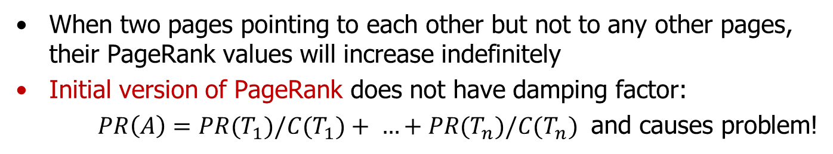
The Rank Sink Problem
When two pages pointing to each other but not to any other pages, their PageRank values will increase indefinitely
Initial version of PageRank does not have damping factor:
$PR\left(A\right)=PR(T_{1})/C(T_{1})+ …+PR(T_{n})/C(T_{n})$ and causes problem!
PR_{i}(A) = Pr_{i-1}(B) + PR_{i -1}(C)
PR_{i}(B) = PR_{i -1}(A)
PR(C) varies, depending on the other pages that C is connected to
But as long as PR(C) remains positive, PR(A) and PR(B) will increase indefinitely; B serves as a temporary storage for A’s previous PR value.
The damping factor d depreciates the PR values in the loop
C
A
B
PR_{i-1}(C)
PR_{i-1}(A)
PR_{i-1}(B)
PR_{i}(A) =
PR_{i-1}(B) +
PR_{i-1}(C) =
PR_{i-2}(A) +
PR_{i-1}(C)
PR_{i}(B) =
PR_{i-1}(A)
PR_{i}(C)

Slide 31
The Random Surfer Model
Link structure determines browsing behaviour
PR(A) is the “probability” a surfer is at page A at a given time
PR(A) could be > 1, so it is not exactly probability; normalization is needed
What will bring a surfer to a page?
The user jumps to a page with probability 1-d by typing in the URL of that page (this is called “teleporting”)
The user follows a link from the page that he is visiting
Assuming that the user will not use the back or forward buttons
Probability to visit A directly is 1-d
Probability to visit A by following a link from a parent is
PR(T₁) : probability that user is already at T₁
d*PR(T₁)/C(T₁) : probability that user clicks the link connecting to A
Random surfer model reflects the dynamic of users
How can you incorporate the dwell time of a user on a page?
T₁
T₂
A
•••
T_{n}

Slide 32
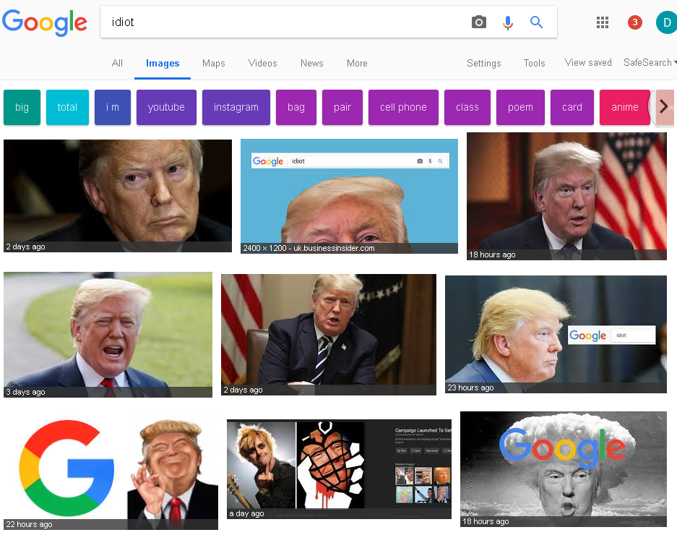
Google Bomb – Link/Content Spamming
Screen captured on July 21, 2018
Webpage search is not affected
Apparently, this bomb is not intentional at the beginning, as compared to the next two examples

Slide 33
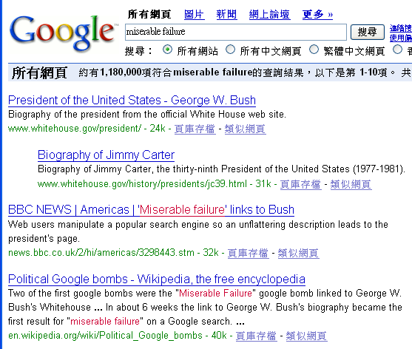
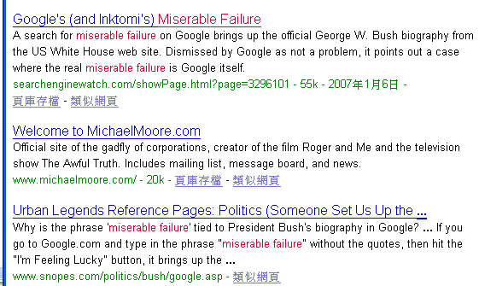
Google Bomb – Link Spamming
Screen captured on Jan 8, 2007
(spamming was reported since 2003; why didn’t Google “fix” it? It was fixed sometimes in Feb 2007)

Slide 34
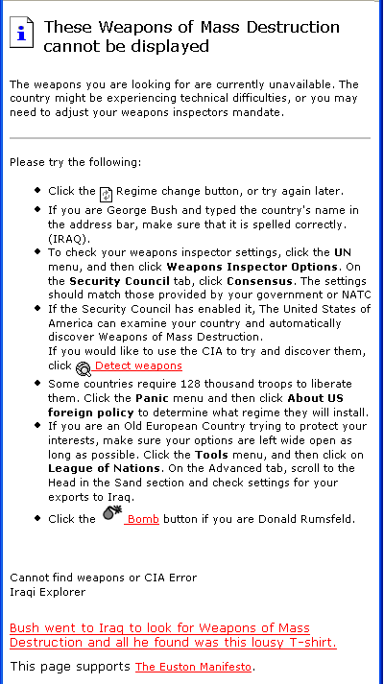
A search on “weapon of massive destruction” return the above page at #1 rank for a few months in the middle of 2003. Google has since “fixed” it. The “404” page was (and still is) hosted at http://www.coxar.pwp.blueyonder.co.uk/

Slide 35
Search Engine Optimization (SEO): Link Boosting
Large sites have higher total page ranks
Given the same content, split the content on as many pages as possible
Your
website
Your
website
Your
website

Slide 36
SEO: Link Boosting (Cont.)
Limit the number of links to other websites to avoid PageRank leaks (Why?)
If you must have the external out-links, place the links on pages with a large number of internal out-links
Which of A, B or C leaks the least (or the most) PageRank?
A
B
C

Slide 37
SEO: Link Boosting (Cont.)
Avoid sinks: Once you are at B, you cannot leave the site at all
Users are forced to leave your sites; bad user experience
Google can easily detect sinks and remove them from its index
Add links to break the sink: Add an external link to B or link back to A where the user can exit gracefully
A
A
A
B
B
B
C
C
C

Slide 38
PageRank: Standing on the Shoulders of Giants
Brin and Page [1998] were NOT the first to compute the importance of an object iteratively
Kleinberg [1998]: rank web pages by authority and hub weights (to be covered later)
Gabried Pinski and Francis Narin [1976]: rank the importance of journals by the number of citations they receive and the importance of the citing journals (impact factor of a journal)
Charles Hubbell [1965]: rank importance of individuals based on the importance of the people who endorse them
Wassily Leontief [1941]: rank importance of an economic sector by the importance of the sectors that supply it
Leontief received the 1973 Nobel Prize in economics for this work

Slide 39
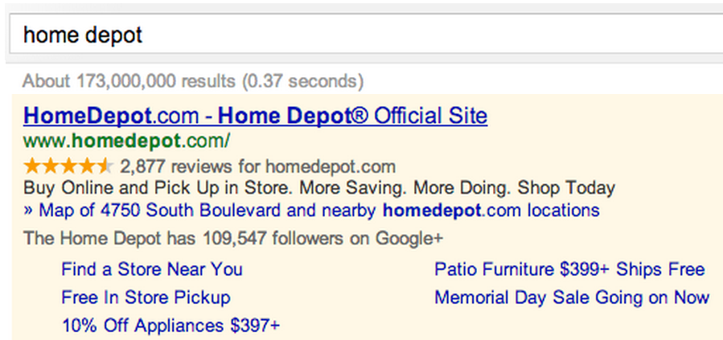
Other “Signals”
PageRank is a signal for the “quality” or “credibility” of a page because people tend to link to high-quality and credible pages
Social signal is another signal, as in:

Slide 40
Why is the Spider Important?
The spider determines the quality of your information source
and it is difficult to do well ...
Running a web crawler is a challenging task…. Crawling is the most fragile application since it involves interacting with hundreds of thousands of web servers and various name servers which are all beyond the control of the system.
Sergey Brin and Lawrence Page, Google Designers
Google won Webby Awards, 2000: http://www.webbyawards.com/
Try some queries: ibm, white house, Dik Lee, etc., and compare results with Bing

Slide 41
Some Engineering Issues with Spider
Spider sends out an http request, web server just hangs (never return the page or an error)
Spider needs last-modify-time to determine if a page has been updated, but web server could return NULL, today's date, or a valid but wrong date (e.g., a future date)
Pages may be password protected
Need to deal with redirects, https, etc.
More subtle:
Duplicate pages with different URLs
Same content but different languages
Dynamic content generated by JavaScript (AJAX)
… …

Slide 42
Comparisons of Hypursuit, WISE and PageRank
Hypursuit | WISE | Google
interprets a link as an indication on the similarity between the connected pages | Interprets a link as an indication on the similarity between the connected pages | Interprets a link as a vote on the authority or quality of the page
Link-based similarity between pages can be computed offline | Similarity is computed between a query and the pages and thus must be computed online | PageRank is dependent only on the Web graph and thus can be computed offline
Link-based similarity is independent of page content | Similarity is based on page content | PR is independent on page content
Link-based similarity is between pages and thus is query independent | Similarity is query dependent | PR is query independent

Slide 43
Notes about PageRank
PR is query independent, i.e., whether the query is “music” or “politics”, the PRs of the pages are the same.
Results for all kinds of queries appear to be good on Google because the queries filter out the pages containing the query keywords (thus they are relevant to the queries to some degree) and PR does the ordering
It sounds simple, but it works!
Google needs to maintain only ONE table containing the PR values of the 20+ billion pages indexed
Rumour has it that Google updates the PR table once a month, leading to the “Google dance” phenomenon

Slide 44
Extensions of PageRank
Topical PageRank: A page may have a high PageRank because it is an authoritative page on investment but it may not be an authoritative page on entertainment, etc.
The Web graph should be segmented by subject, e.g., one sub-graph for entertainment, and then PR values are computed within the sub-graph.
Random surfer: In the PR formula (i.e., random surfer model), every page has equal probability (as defined by d) for direct visit (i.e., not by following links but by direct entering URL or bookmarks), this is not true in real life. To deal with the difference, every page should have its own d value: PR(A) = (1-d(A)) + d(A)(… …) d(A) has to be estimated from bookmarks and web server logs, but unfortunately these things are not available in public

